Slide 1
E-Cigarettes: Mike Seilback National Assistant Vice President, State Public Policy
Notes:
I oversee the Lung Association's state and local policy efforts across the country
And as a New Yorker – I continue to do a lot of advocacy work locally.
I am going to start quickly with a broad oversight and then move to a more local level.

Slide 2
Addressing the Epidemic: American Lung Association Leadership
Sounding the alarm since the beginning
“The American Lung Association urges FDA to crack down on the sales and marketing of such products, which appear to be in violation of the law.”
Notes:
Let’s first take the youth e-cigarette epidemic – with 27.5 percent of kids using these products.
This was an American Lung Association call to action in 2009 – 10 years ago.
Since that time, the Lung Association has been leading efforts to educate the public about e-cigarettes, and spur action by federal, state and local governments.

Slide 3
E-cigarettes in the US
Brief history
2007 - E-cigarettes first appear in U.S. markets from China
2009 - FDA seeks to regulate e-cigarettes as drug/medical device. E-cigarette companies sue to be regulated as a tobacco product.
2011 - FDA announces its intent to move forward regulating e-cigarettes as tobacco products unless the manufacturer makes a quit-smoking claim.
2015 – FDA finally issues its proposal on how it would regulate e-cigarettes
2016 – FDA finalizes its authority and on August 8, FDA regulatory authority over e-cigarettes begins
2017 – FDA announces manufacturers will not have to submit e-cigarettes for review until 2022
2018 – Public health groups sue FDA over delay
2019 – Federal judge sides with public health groups; gives FDA May 2020 deadline
2019 – Lung injuries and some deaths occurring in thousands of vapers
2019 – Pres. Trump & Secretary Azar announce they will “clear the markets” of flavored e-cigarettes – largely in response to the 27.8 percent of youth e-cigarette use
Notes:
This is a very brief history of FDA’s authority over e-cigarettes.
Be sure to note the 4 year gap between 2011 and 2015 between the time FDA announced it would begin to regulate e-cigarettes and when it issued its proposal. It took FDA another year to finalize its authority.
And in 2018, FDA told manufacturers that the agency would delay the deadline for submitting their products for FDA review from 2018 to 2022. The American Lung Association and our partners sued FDA for this “arbitrary and capricious” delay. In May 2019, a federal judge sided with us and ruled that FDA is required to have all pre-market applications submitted by May of 2020.
On September 11, President and First Lady Trump and HHS Secretary Azar announce that in the coming weeks FDA will “clear the market” of all non-tobacco flavored e-cigarettes.

Slide 4
Trump Administration Announces Action
Notes:
September 11- Secretary Azar announces The Food and Drug Administration is currently finalizing its guidance to remove all non-tobacco flavors of e-cigarettes, including mint and menthol, from the market within 30 days. Companies might be able to reintroduce their flavors at a later date, so long as they submit a formal application and receive approval from the FDA.
Within weeks.
Been over a month.
There are also several bills pending before Congress-
Tobacco 21 federally
Congressman Pallone’s bill
Putting aside federal action – what is happening on the state and local level?

Slide 5
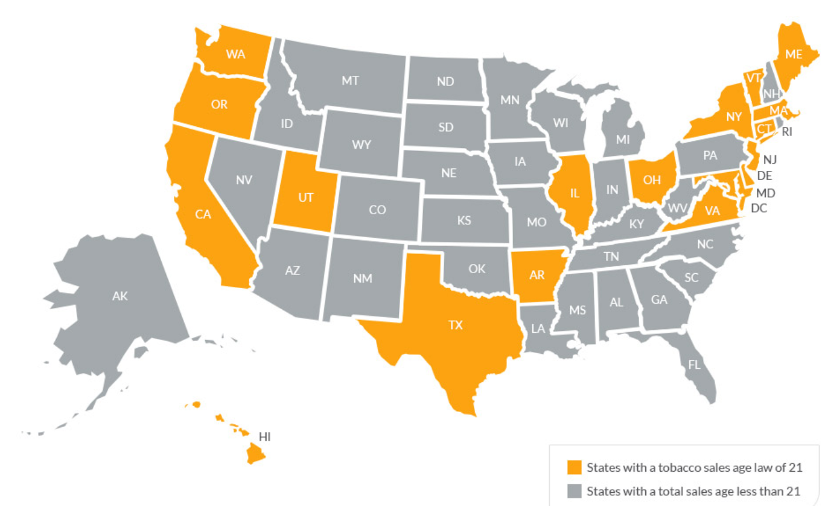
What have states done?
Notes:
The American Lung Association strongly supports including or adding e-cigarettes into smokefree laws. As of July 2019, 15 states and the District of Columbia have added e-cigarettes to their comprehensive laws prohibiting smoking in virtually all public places and workplaces.
Tobacco 21:

Slide 6
What about here in New York?
Smokefree laws
Tobacco 21
Tax
Flavors
Emergency Action
Local Legislation
Notes:
NYC, Albany County, Westchester County, Nassau County, Suffolk County
Hosting a Regional Cannabis and Vaping Summit in New York City with Connecticut, New Jersey and Pennsylvania governors.
20% tax goes effect in December
T21 goes effect in November

Slide 7
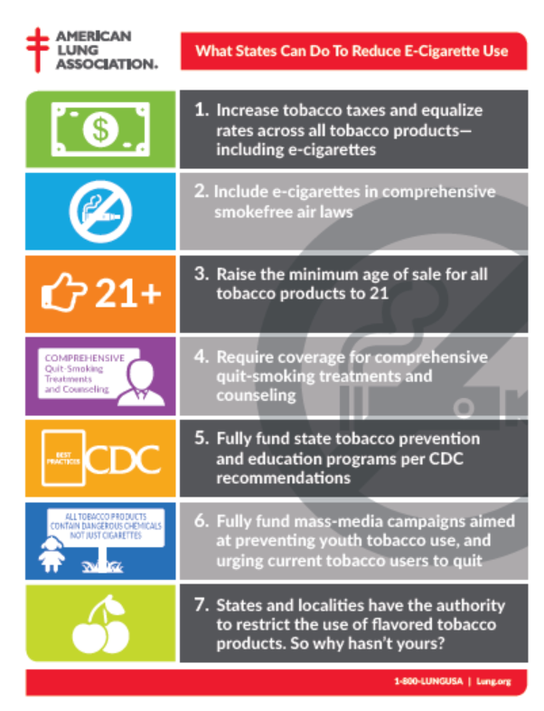
Addressing the Epidemic: American Lung Association Leadership
States and localities can work to fill the void
While FDA delays, states and localities can and should act
Prohibiting flavors in all products
Smokefree protections
Tobacco 21 policies
Helping smokers quit
Funding tobacco prevention programs
Increase tobacco taxes
Do more to help smokers and e-cigarette users quit
Notes:
In the absence of FDA acting, the American Lung Association is working at the state and local level, urging them to take actions that are proven to reduce tobacco use and help smokers get real help to quit.
And we call on states and localities to prohibit all flavored tobacco products, including mint and menthol e-cigarettes, and menthol cigarettes and flavored cigars.
We call on states and localities to include e-cigarettes in comprehensive smokefree laws. In November, Florida voters passed an initiative that will prohibit e-cigarette use indoors.
We call on states and localities to join the 6 states, DC and over 350 localities that have passed Tobacco 21 laws raising the legal age of sale for tobacco products to 21.
We call on states to fully fund programs which help prevent kids from starting to use these products and help current users quit.
We call on states to increase tobacco taxes including e-cigarettes. The American Lung Association believes e-cigarettes should be taxed at the same amount as other tobacco products.

Slide 8
Addressing the Epidemic: American Lung Association Leadership
What should parents & teens know?
The Vape Talk -
“Juuling” is using an e-cigarette
Permanent damage can occur to kids lungs & brain development
Secondhand e-cigarette emissions are harmful
Notes:
The American Lung Association created “The Vape Talk” to help parents learn how to talk with their kids about the dangers of e-cigarettes and vaping.

Slide 9
Addressing the Epidemic: American Lung Association Leadership
Help kids with their addiction – don’t punish them
Notes:
It’s important that schools understand that these kids are heavily addicted – and that kids need to be treated, not punished.
The Lung Association opposes the use of e-cigarette detection machines, of removing bathroom doors, etc. Instead, we emphasize the use of prevention and education.

Slide 10
Where to Find More Information
TheVapeTalk.org – Resources for parents to talk with their kids
Lung.org/INDEPTH – The Lung Association’s alternative to suspension program
Lung.org/ecigs – The Lung Association’s page on all things e-cigarettes and vaping

Slide 11
Additional Questions?
Mike Seilback
Michael.Seilback@Lung.org
Liz Hamlin
Elizabeth.Hamlin@Lung.org

